Slide 1

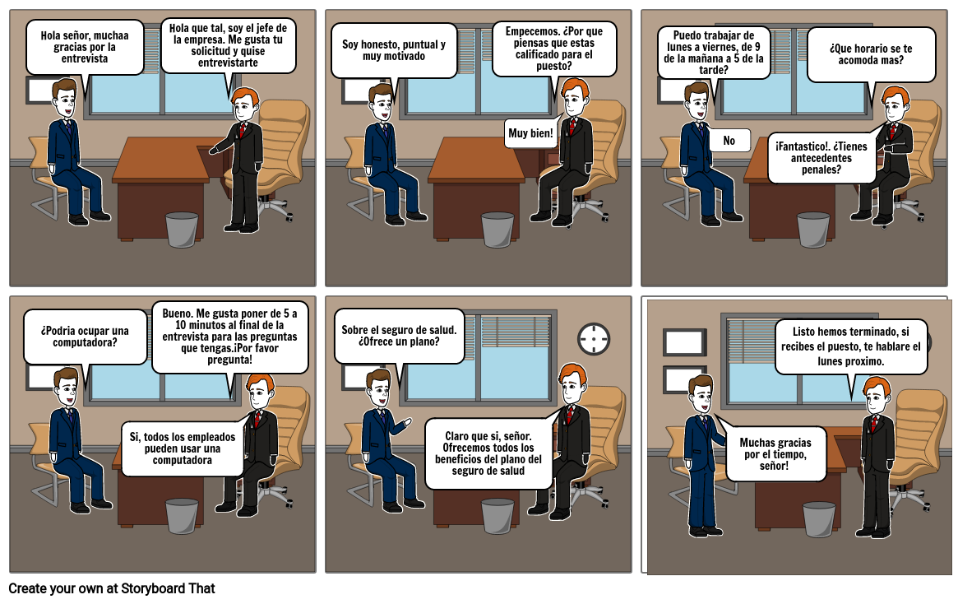
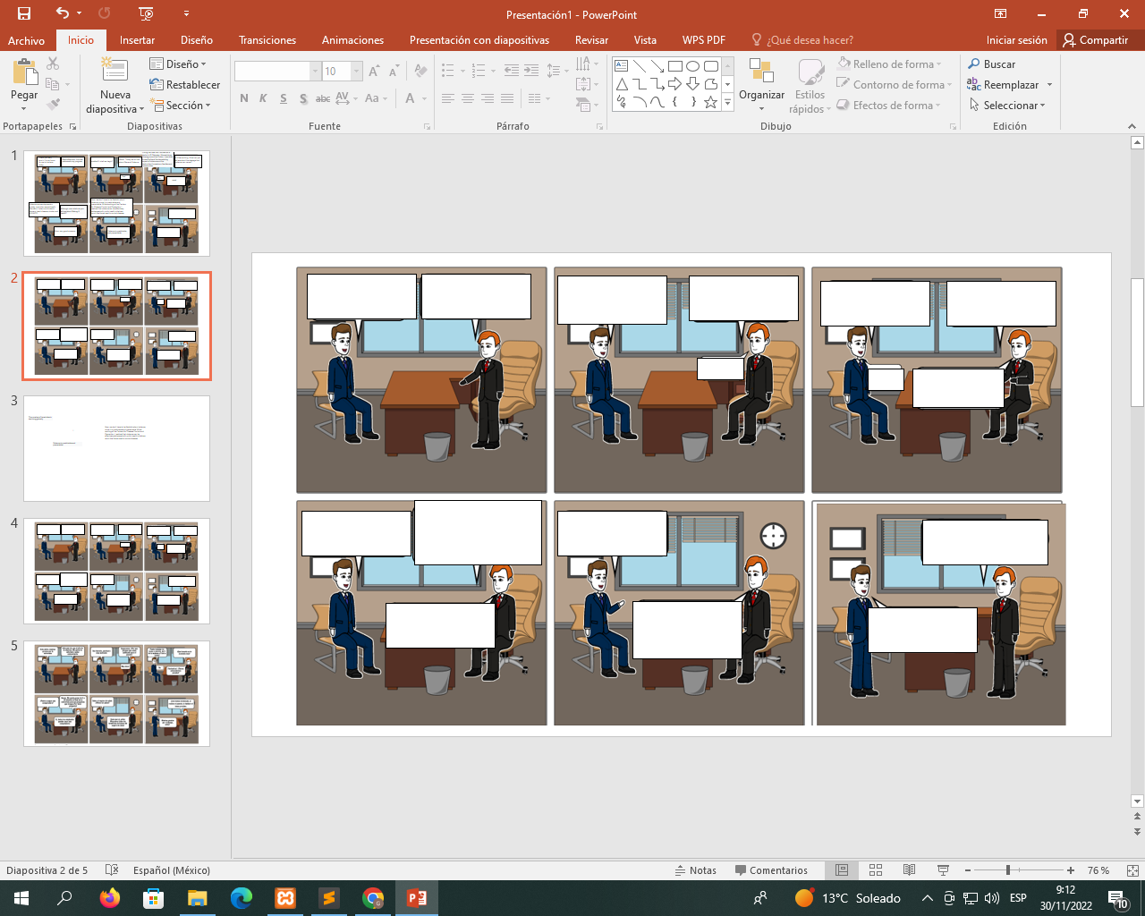
During the time that I worked as a doctor in El Salvador, Mozambique, Nicaragua and the Sudan, I was able to see firsthand the devastating impact of violence and the destruction it wreaks on families and communities.
Thank you very much. It is an honor for me to be here today.
Good afternoon. You are welcome to my program.
Good!. Today we will talk about General Violence
Dr Etienne Krug. What can you tell me about the damage that violence can cause?
excellent!!! shall we begin?
Yes!
ooh!
wow!
The conclusions of the report seem encouraging to me; For example, in many countries violence is now discussed as a public health problem, and more and more countries are developing and implementing violence prevention programs and laws and establishing services for victims.
Now, we don't have to be fatalistic about violence, since it is predictable and preventable. While working at the Centers for Disease Control and Prevention, I realized that violence can be effectively addressed with public health initiatives much like those used to control disease.
Violence causes depression, anxiety, and other mental health disorders. It also contributes to cancers, heart disease, stroke, and HIV/AIDS.
Although, now what can you tell me about lifelong ill health?
The number of homicides is declining globally
Very well
Wow, very good answers.
Violence is predictable and preventable.

Slide 2
Violence has enormous social and health consequences. Violence causes many deaths every day, particularly among young men and boys. In addition to this death rate, large numbers of men, women, boys, and girls suffer injuries, disabilities, or health problems as a result of violence.
Approximately 470,000 people are victims of homicide each year
Now tell me, why is violence of interest to Public Health?
Finally, could you give me some key information?
The pleasure is mine.
I want to tell you that I loved interviewing you.
Thanks.
excellent!!!
About 38% of all murders of women are perpetrated by their intimate partners.
1 in 3 women have experienced physical and/or sexual violence, most by an intimate partner

Slide 3
Reporta las respuestas en INDIRECT SPEECH
ENTREVISTA SOBRE LA VIOLENCIA (INTERVIEW ON VIOLENCE)
He said that the honor is for him, to be there today | El dijo que el honor es para el, estar el dia de hoy hay
He asked the question that they should start now | El realizo la pregunta sobre que ya deberian comenzar
He said that During his time working as a doctor in El Salvador, Mozambique, Nicaragua and Sudan, he was able to see firsthand the devastating impact of violence and the destruction it wreaks on families and communities. | El dijo que Durante el tiempo que trabajo como médico en El Salvador, Mozambique, Nicaragua y Sudán, pudo ver de primera mano el impacto devastador de la violencia y la destrucción que causa en las familias y comunidades.
He said that Violence causes depression, anxiety and other mental health disorders. It also contributes to cancers, heart disease, stroke, and HIV/AIDS. | El dijo que La violencia causa depresión, ansiedad y otros trastornos de salud mental. También contribuye a los cánceres, las enfermedades cardíacas, los accidentes cerebrovasculares y el VIH/SIDA.
He said that Now, we don't have to be fatalistic about violence, as it is predictable and preventable. While working at the Centers for Disease Control and Prevention, she realized that violence can be effectively addressed with public health initiatives much like those used to control disease. | El dijo que Ahora, no tenemos que ser fatalistas acerca de la violencia, ya que es predecible y prevenible. Mientras trabajaban en los Centros para el Control y la Prevención de Enfermedades, se dio cuenta de que la violencia se puede abordar de manera efectiva con iniciativas de salud públicas muy parecidas a las que se utilizan para controlar las enfermedades.

Slide 4
He said that he finds the report's conclusions encouraging; For example, in many countries violence is now discussed as a public health problem, and more and more countries are developing and implementing violence prevention programs and laws and providing services for victims. | El dijo que Las conclusiones del informe le parecen alentadoras; Por ejemplo, en muchos países la violencia ahora se discute como un problema de salud pública, y cada vez más países están desarrollando e implementando programas y leyes de prevención de la violencia y proporcionando servicios para las víctimas.
He said that Violence has enormous social and health consequences. Violence causes many deaths every day, particularly among young men and boys. of violence. | El dijo que La violencia tiene enormes consecuencias sociales y sanitarias. La violencia causa muchas muertes todos los días, particularmente entre hombres jóvenes y niños. de la violencia.
He said that Approximately 470,000 people are victims of homicide each year | Dijo que Aproximadamente 470.000 personas son víctimas de homicidio cada año
He said goodbye and said The pleasure is mine. | Se despidió y dijo El placer es mío.
!

Slide 5
https://www.who.int/es/news-room/commentaries/detail/violence-can-affect-anyone
!
GIMENA DEL ANGEL LICONA
DAIANA SHERLYN MARTINEZ PERALTA

